Slide 1
Grade 5
3

Slide 4
GAME TIME

Slide 5
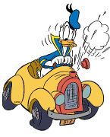
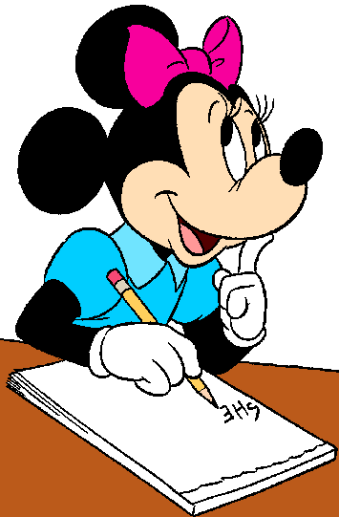
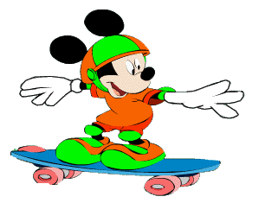
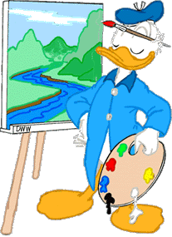
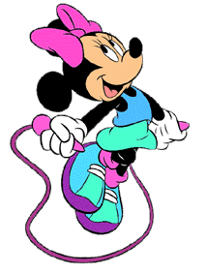
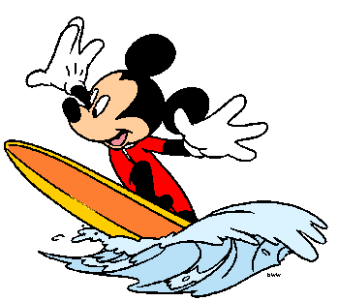
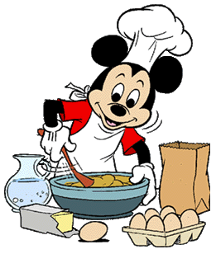
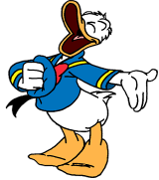
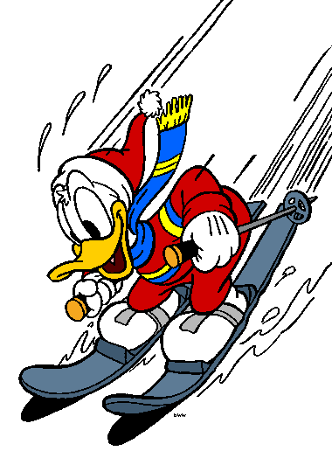
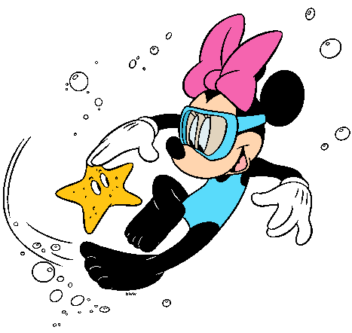
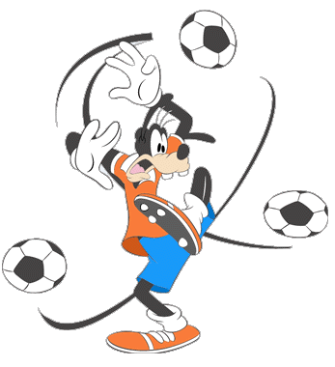
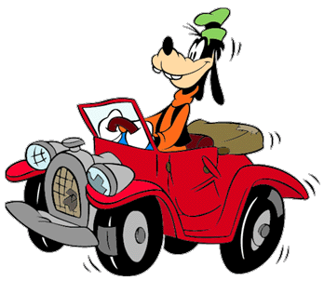
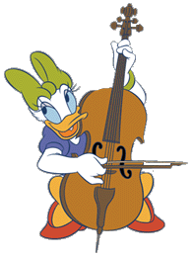
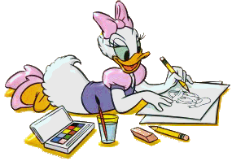
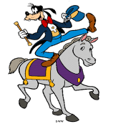
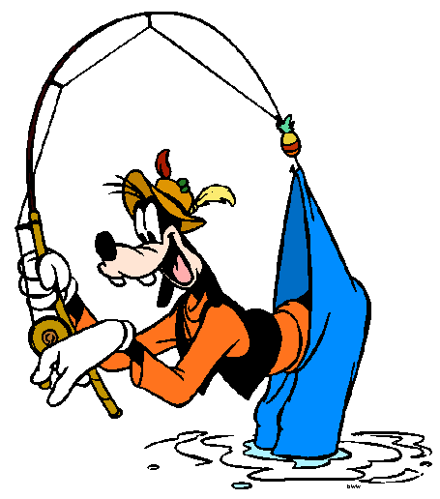
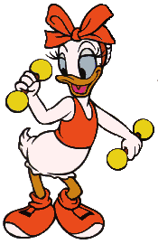
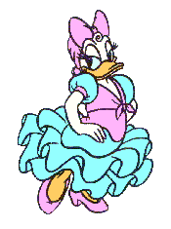
WHAT WILL THEY DO?

Slide 7
read
Mickey will _____ and _____...
surf
a
play
r
do
read
ride
paint
dance
use
cook
surf
write
skip
r
a
fish
dive
drive
sing
draw
rollerskate
…but he won’t _____ or ______.
cook
rollerskate

Slide 8
Minnie will ____ and __ a computer...
write
use
do
play
r
read
a
ride
paint
dance
use
cook
surf
write
skip
a
r
fish
dive
drive
sing
draw
rollerskate
…but she won’t _____ or ______.
skip
dive

Slide 9
drive
Goofy will ___ a horse and ____ a car...
ride
a
do
play
r
read
ride
paint
dance
use
cook
surf
write
skip
r
fish
dive
drive
sing
a
draw
rollerskate
…but he won’t _____ football or ______.
play
fish

Slide 10
Daisy will ___ exercise and _____...
do
draw
a
do
play
read
ride
r
paint
dance
use
cook
surf
write
skip
r
fish
dive
drive
sing
a
draw
rollerskate
…but she won’t ____ the cello or ______.
play
dance

Slide 11
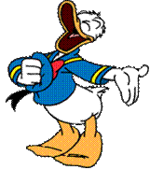
Donald will ______and ______...
sing
paint
do
play
r
a
read
ride
paint
dance
use
cook
surf
write
skip
a
ski
r
fish
dive
drive
sing
draw
rollerskate
drive
…but he won’t ______ a car or ______.
ski

Slide 12
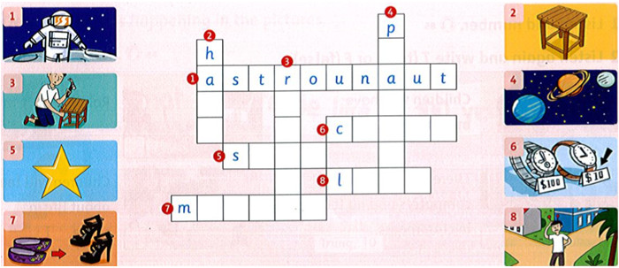
Complete the crossword

Slide 13
Complete the crossword
l
r
e
n
h
e
a
p
d
p
t
a
r
t
i
o
s
t
o
d
e
r
n

Slide 14
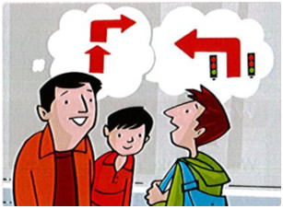
Write: straight, right, left, traffic lights
Yesterday I was with my dad outside my house. A man asked, "Excuse me, where's the station?" My dad said, "Go ¹straight, then turn ²_____ . At the ³_________, turn ⁴_____ and it's in front of you". "Thank you", said the man. "You know the city well." "That's because I'm a taxi driver," my dad said.
right
traffic lights
left

Slide 15
LISTEN AND SING

Slide 17
Write: why, because
Hoa: ¹Why are you smiling?
Millie: ² __________ I'm happy.
Hoa: ³ _________ are you so happy?
Millie: ⁴_________ I won this trophy.
Hoa: ⁵ _________ did you win the trophy?
Millie: I won it ⁶________ I'm the fastest runner at school. ⁷______ are you asking so many questions?
Because
Why
Because
Why
Because
Why

Slide 18
Read and write T (true) or F (false)
1. The orange flowers are the least beautiful. __T___
2. The red flowers are the most expensive. ______
3. The purple flowers are the cheapest. _____
4. The purple flowers are more expensive than the yellow and white ones. ____
5. The yellow and white flowers are less
beautiful than the orange ones. ____
T
F
T
F

Slide 19
Write the words under the correct headings
pencil, yogurt, orange, gloves, picnic, cucumber, page, police
c says c | c say s pencil | g says g | g say j

Slide 20
Write the words under the correct headings
pencil, yogurt, orange, gloves, picnic, cucumber, page, police
c says c picnic cucumber | c say s pencil police | g says g yogurt gloves | g say j orange page

Slide 21
WORKBOOK TIME

Slide 22
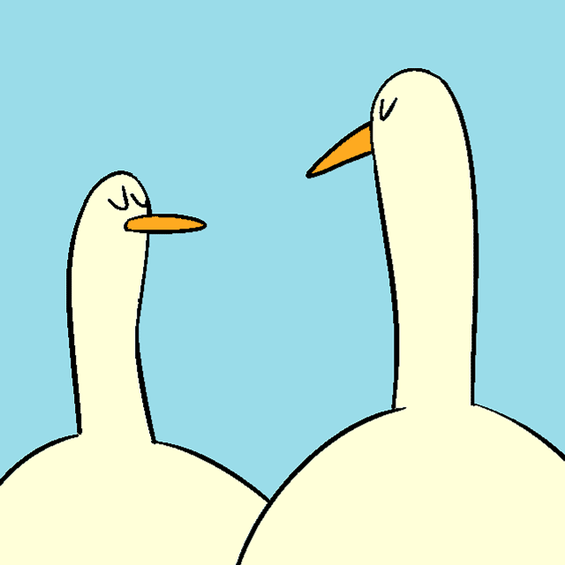
GOODBYE!!!

